Slide 1

How do we support the Mental Health and Wellbeing of pupils?

Slide 2

School approaches
Zones of Regulation
Russian dolls for sharing worries
PSHE curriculum
Supporting transitions to classes/new schools

Slide 3
Zones of Regulation
https://www.youtube.com/watch?v=L0e-oMZi000

Slide 4
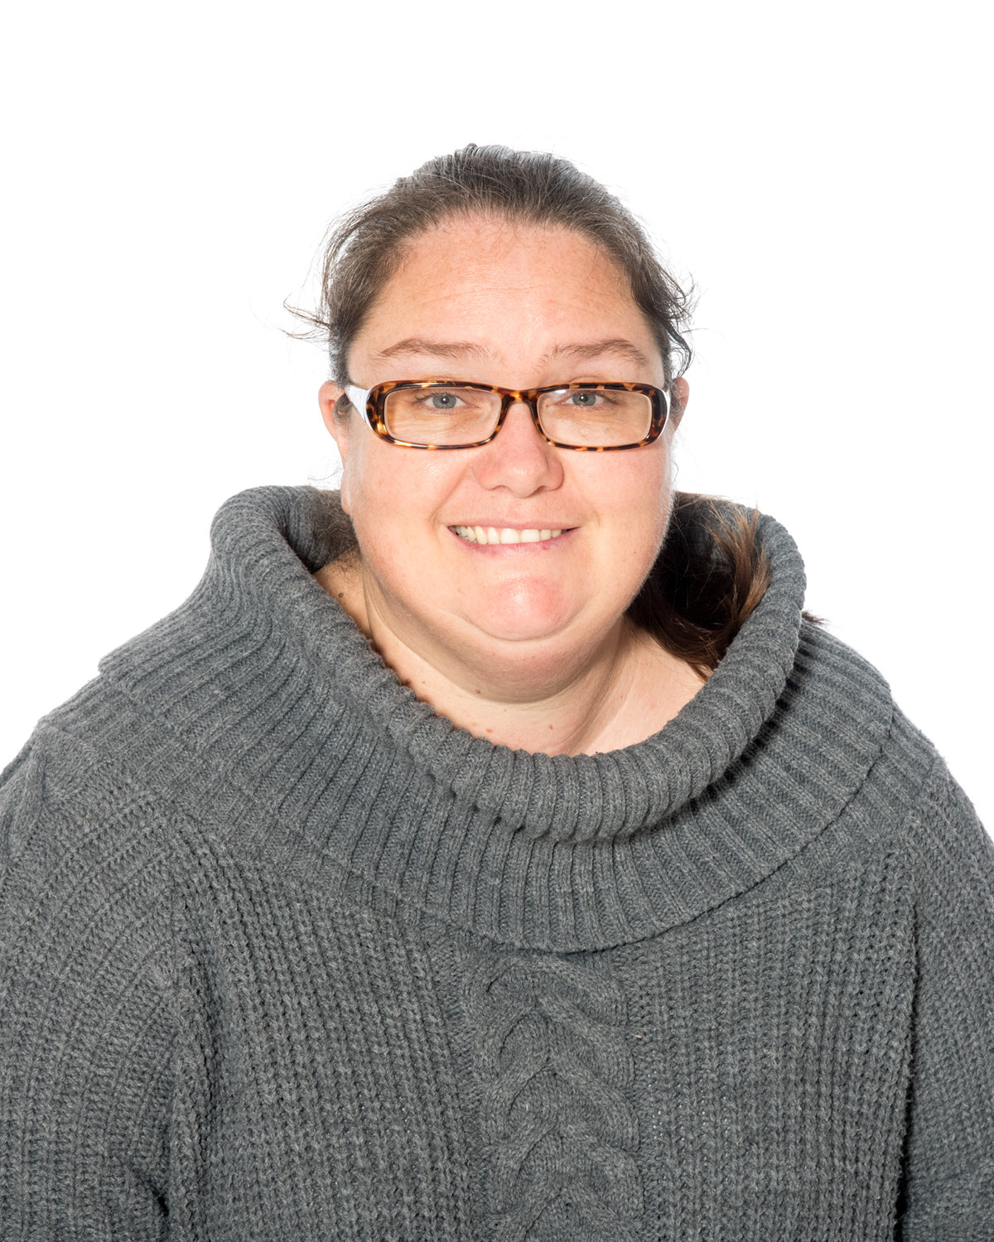
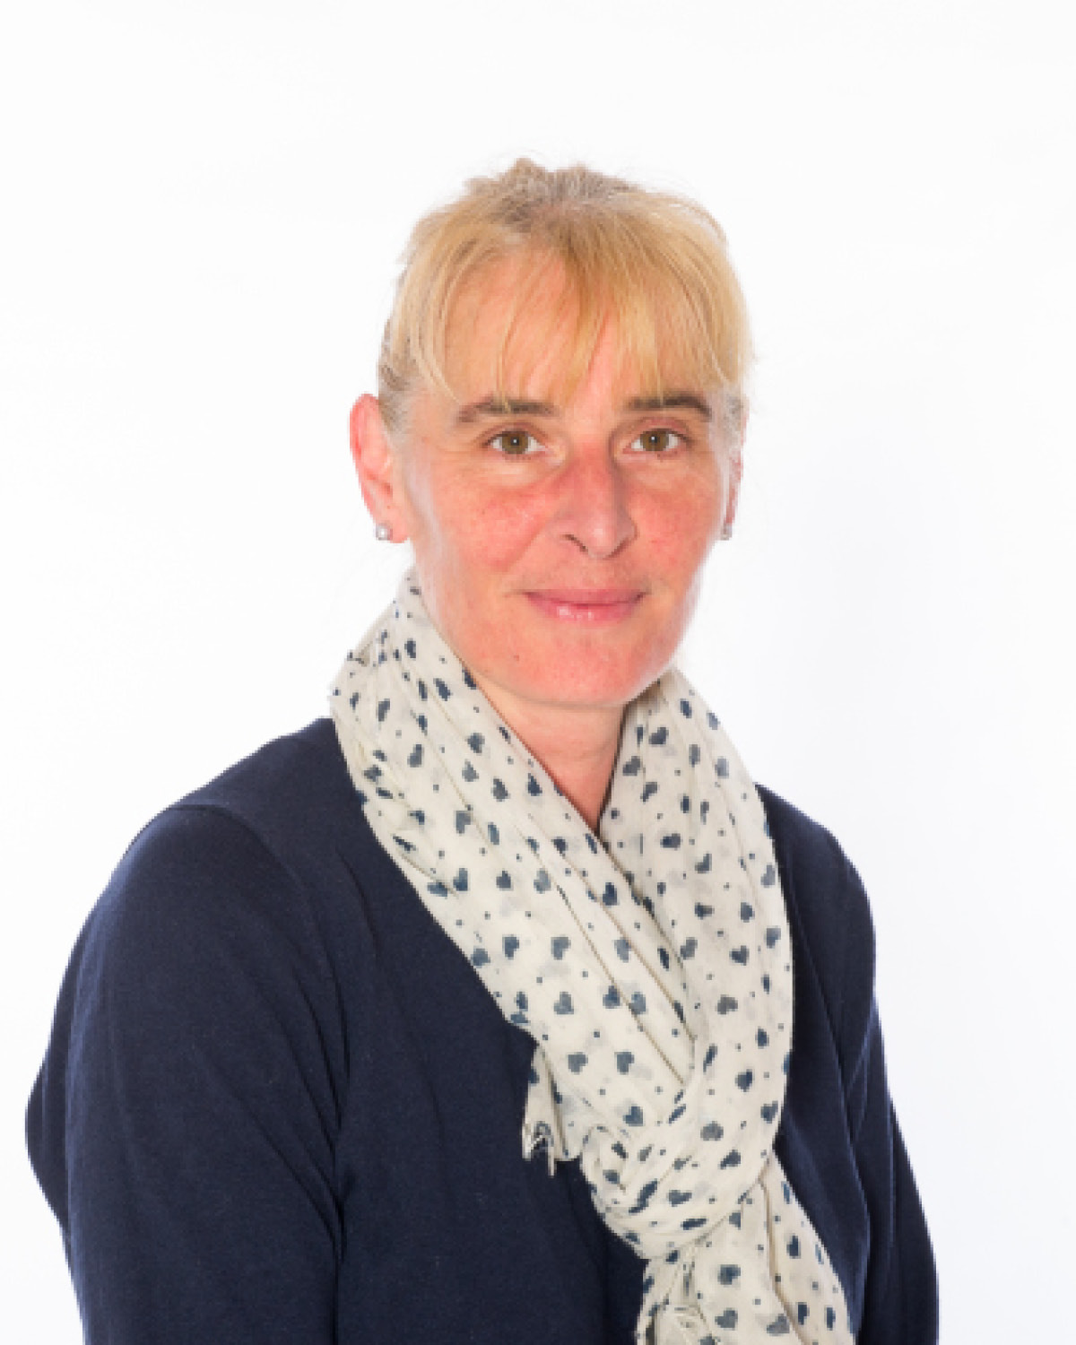
ELSA – Emotional Literacy Support Assistants
What?
6 week block of 1:1 sessions to
Address individual needs
emotions, friendships, self- esteem, bereavement
Who?
Termly PPM meetings
SENCo
Parents
Mrs. Judy Andrews-Callec
Mrs. Lisa Vernon

Slide 5
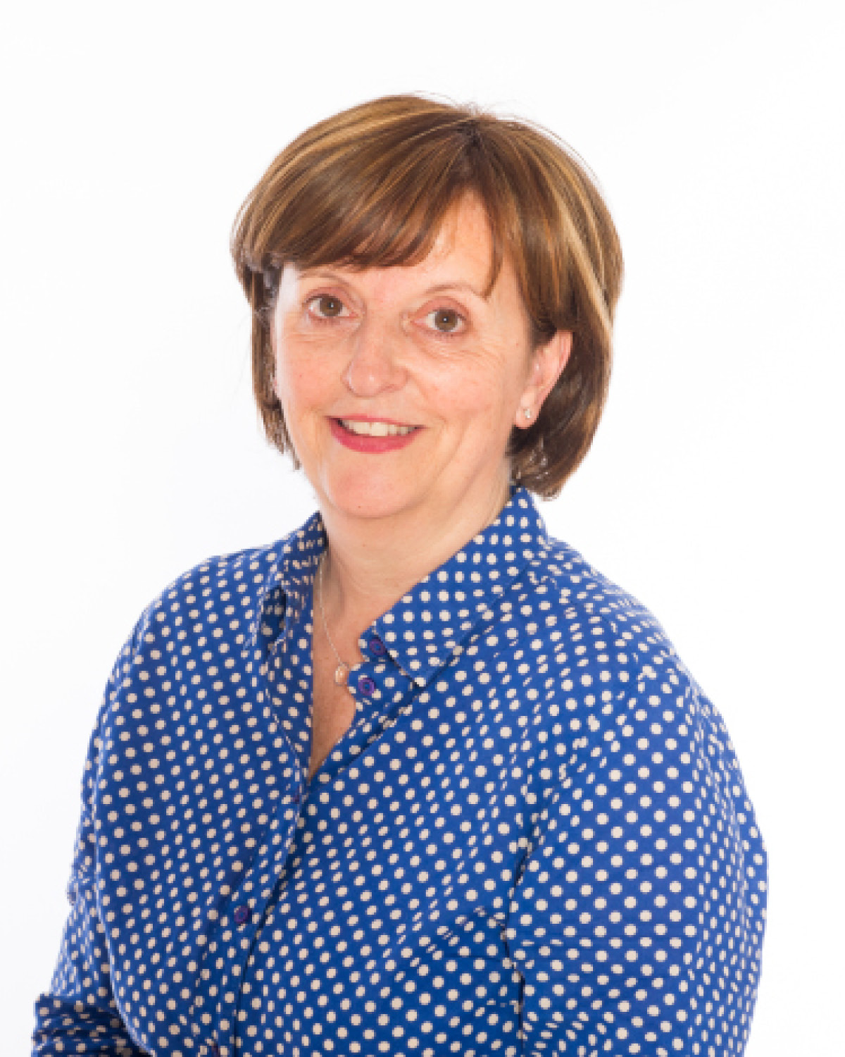
Mental Health First Aider
Mrs Donna Tupper

Slide 6
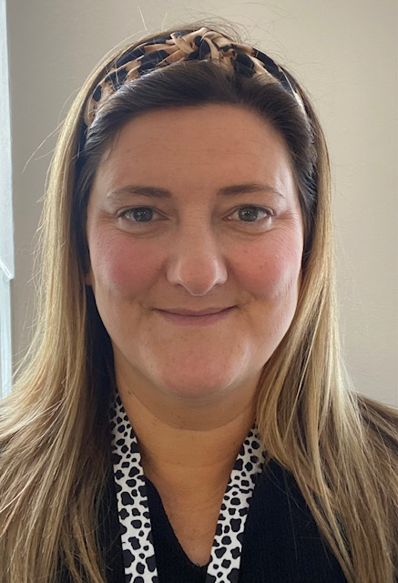

Catriona Sims – Well-being facilitator
My name is Cat Sims and I am a proud member of the psychology and well-being team. In my role as a well-being facilitator, I work with children on a 1:1 basis, group sessions and I also deliver whole class sessions. We support young children to identify and recognise different feelings and emotions and how to deal with these in a healthy way.
We explore our emotions by using therapeutic stories, games and art activities that are age appropriate and engaging.
Our individual well-being programme consists of six sessions, in which we focus on our personal strengths, support networks, coping strategies and how to boost self-esteem. As a team we plan and deliver a number of class sessions which cover friendship skills, transitions, coping skills and also acceptance and understanding.

