Slide 1
Children and Families Hub
Letitia Bradley – Team Manager – Additional Needs Team

Slide 2

A single point of contact and referral for children, young people and families who require additional support available Monday – Friday during office hours to both members of the public and practitioners
Purpose is to ensure children and families get the right help at the right time so that children are appropriately supported, safeguarded and protected
From February 2022, all CAMHS referrals have been coming through the Children and Families Hub using the same request for support form
Notes:
The Children and Families Hub was established in March 2020 as part of the response to the Jersey Care Inquiry and the recommendations of the JCC that were informed by Ofsted’s inspection of CSC and identified that early help was very underdeveloped in Jersey

Slide 3
Jersey’s Children First
a standard framework adopted across agencies in the public, community and voluntary sectors
for all those working with children and young people from pre-birth with emerging or known additional or complex needs/disabilities, including children in care and those in need of protection.
enables agencies to work together effectively to ensure children, young people and families can access the right help at the right time and from the right service
the vehicle for delivering the four outcomes of the Children’s Plan that all children in Jersey:
  grow up safely
  live healthy lives
  learn and achieve
  are valued and involved
  https://www.youtube.com/watch?v=sBRSfh0ZMjs
Notes:
In 2018 a standard practice framework was developed and adopted across agencies in the public, community and voluntary sectors
for all those working with children and young people from pre-birth with emerging or known additional or complex needs/disabilities, including children in care and those in need of protection.
The shared framework enables agencies to work together effectively to ensure children, young people and families can access the right help at the right time and from the right service
It is the vehicle for delivering the four outcomes of the Children’s Plan that all children in Jersey:
grow up safely
live healthy lives
learn and achieve
are valued and involved

Slide 4
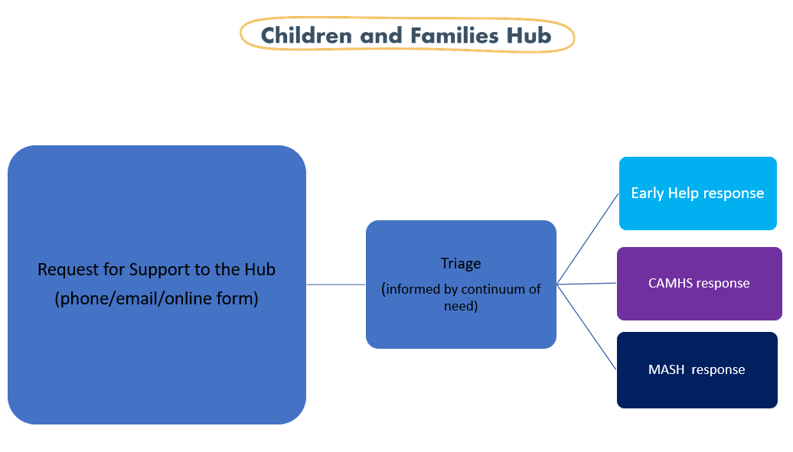
Notes:
Requests for support may be received from members of the public by email or phone and from practitioners by the online request for support form.
Each request is triaged by a children and families hub decision maker- they may request a joint triage with the MASH decision maker and from this month with the CAMHS decision maker.
The request may be triaged for an early help response, a MASH response or a CAMHS response.
In 2021, 2787 contacts were made over the year, with 94 of these being made by ED.
In 2021 a third of contacts were triaged for a MASH response with the remainder receiving an early help response.

Slide 5
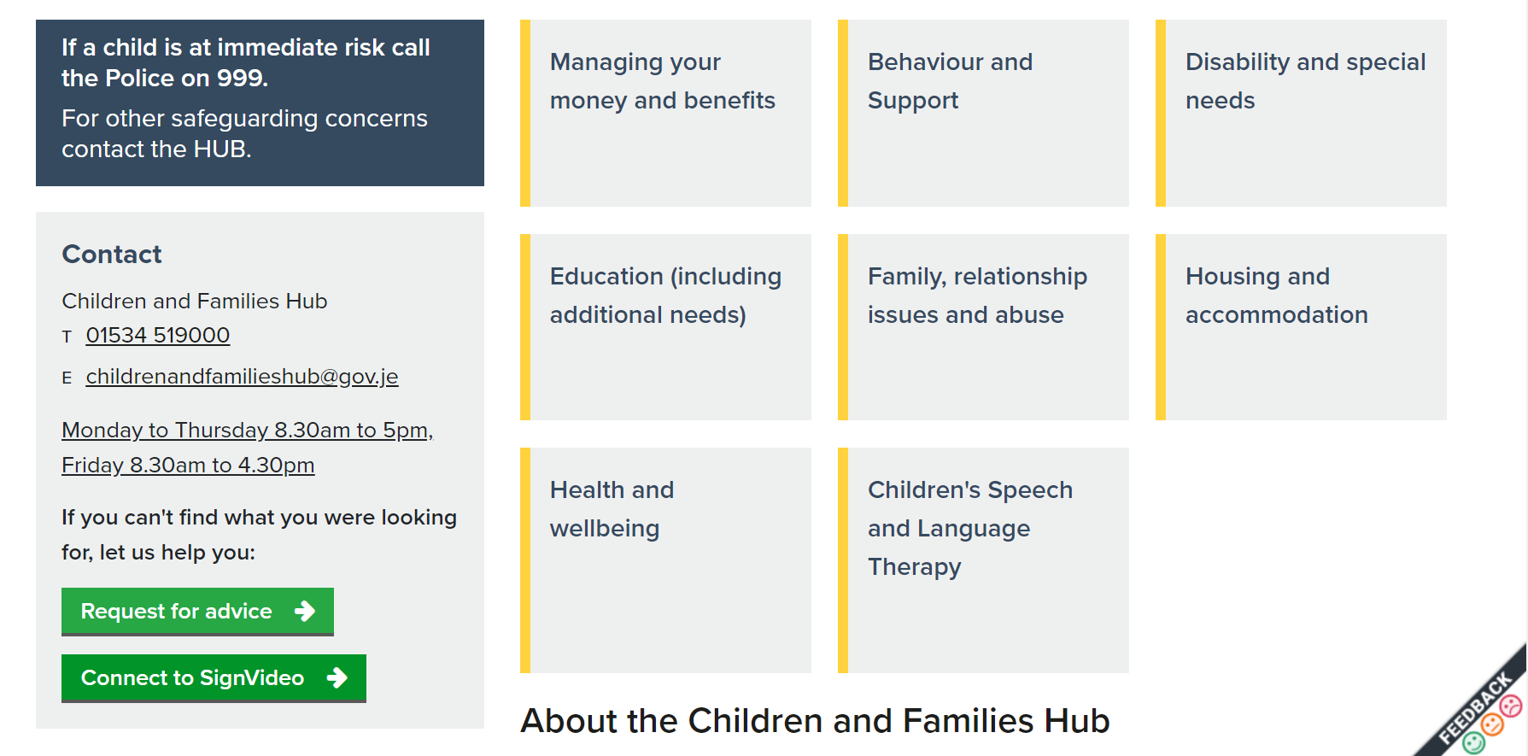


Slide 6
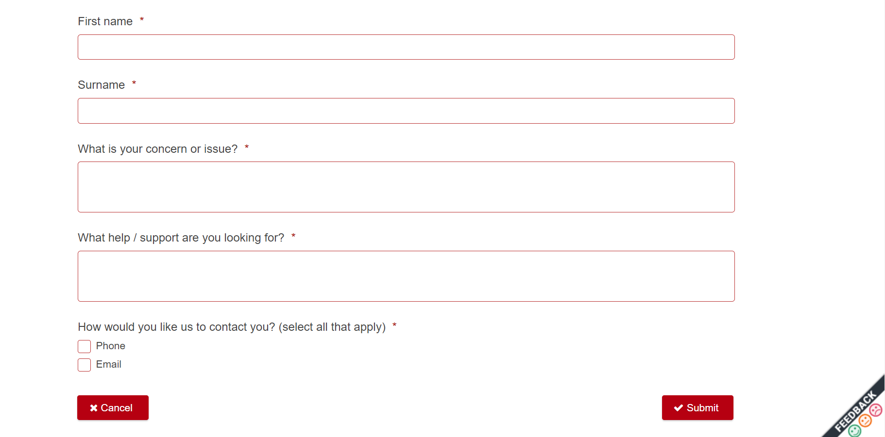

Slide 7
Parenting Programmes
Universal Offer
Triple P: Seminars, Discussion Groups, 5-12 years, Teen Triple P, Stepping Stones
Targeted Support
New Forest Parenting Programme (NFPP)
Who’s in Charge (WiC)
Family Transitions
Time to Pause
Early Bird / Early Bird +
Refer via Children and Families Hub

