Slide 1
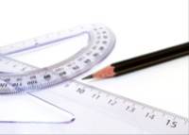


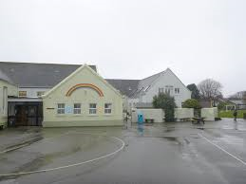
Counter bullying approaches
St Saviour’s School
CYPES – IEI Service
Presentation for Parents
Presented by Dr Graham Ramsden

Slide 2
Context
St Saviour’s School does not have any more difficulties with bullying than any other school. This presentation has been organised because of their proactive child-centred approach to schooling rather than there being a heightened need for it to be addressed.

Slide 3
Terminology
Education Department
It is important to use the term ‘children who bully’ rather than ‘bullies’ as it allows us to look at the whole child rather than pre-judging their behaviours and motives (definition based).

Slide 4
Bullying is not…
Education Department
A fight because of a disagreement
Name calling in the corridor – reactive incident
A push, a shove, a trip or a punch
One-off comments
Someone being beaten up on the way home
Theft of someone’s property
…..unless

Slide 5
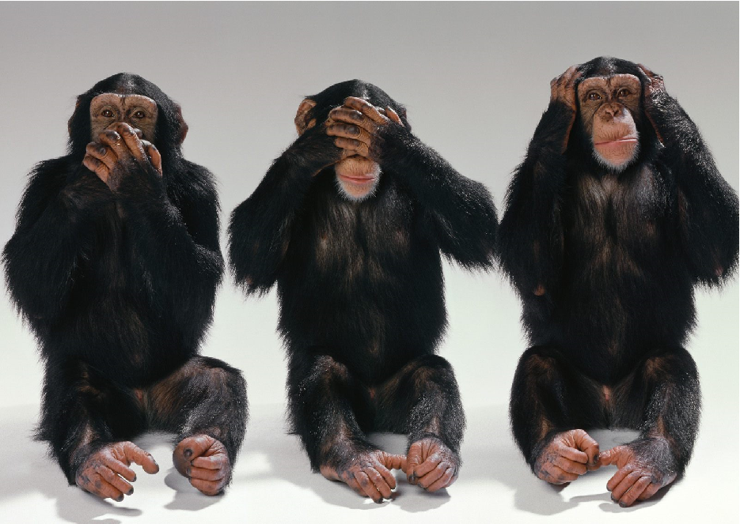
Un-intentional bullying

Slide 6
What about…
Laughing at an incident in which something silly happened to someone (splashed by a car)
Liking a horrible picture of them on facebook
Cheering when they trip up/fall off their chair
Getting someone to do something they don’t want to do (as a one-off)
Is it bullying if it is happening a lot to the same person but from lots of different people who are not aware other people are doing it?

Slide 7
Tension vs Intention
Stress is a common causal factor of poor behaviour or poor behavioural choices
When determining a case of bullying we must look at the intention behind the behaviour

Slide 8
Research based definitions
Education Department
Descriptor | Frequency | Cited by
Negative aggression | 3 | Olweus (1999) Sullivan, Cleary Sullivan (2005), Smith, Pepler & Rigby (2004)
Occurs one or more times | 1 | Sullivan, Cleary Sullivan (2005)
Physical | 3 | Sullivan, Cleary Sullivan (2005); Elliott (1992); Baker & Smith (2005)
Psychological | 3 | Sullivan, Cleary Sullivan (2005); Field (2007); Baker & Smith (2005)
emotional | 4 | Sullivan, Cleary Sullivan (2005); Elliott (1992); Field (2007); Baker & Smith (2005)
premeditated | 2 | Elliott (1992); Baker & Smith (2005)
Pain and distress | 2 | (Olweus (1999) Baker & Smith (2005)
persistent | 1 | Baker & Smith (2005)
Intentional /deliberate | 3 | Elliott (1992); Field (2007): Smith, Pepler & Rigby (2004)
Imbalance of power | 4 | Heinemann (1973); Field (2007); Baker & Smith (2005); Smith, Pepler & Rigby (2004)
Organised systematic | 2 | Sullivan, Cleary Sullivan (2005); Elliott (1992)
hidden | 1 | Sullivan, Cleary Sullivan (2005)
Sexual/ racial elements | 1 | Smith, Pepler & Rigby (2004)

Slide 9
What bullying is…
Education Department
Targeted - systematic
Pre-meditated
Intended to cause harm – physical and/or emotional
Occurs over a period of time – may have a pattern
Involve a sustained imbalance of power over another person

Slide 10
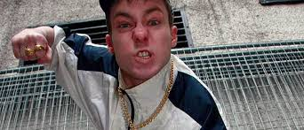
Social Problem Solving Skills
How would you deal with this person?
His SPSS is to use aggression

Slide 11
Jersey Schools anti-bullying project 2018-19

Slide 12
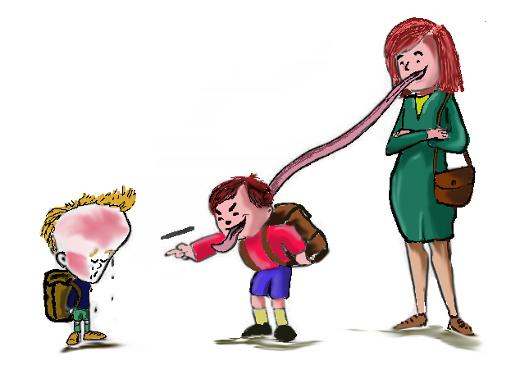
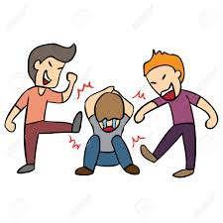
Pupils
Parents
School Culture
and
Systems

Slide 13
The project looked at developing more bespoke resources for staff, pupils and parents.
It utilised research from the past 40 years
Endeavours to change the way we view and deal with bullying in our communities

Slide 14
Aims of the project
To approach the management of bullying from a different perspective
Develop a greater understanding of what bullying is and is not and how best to deal with it.
To utilise the school’s greatest resource in managing bullying – its pupils
Use new resources and measure their effectiveness
Involve parents more directly in helping to support the effective management of the situation
Emphasising the need to help the bully as much as the victim - pity not punish

Slide 15
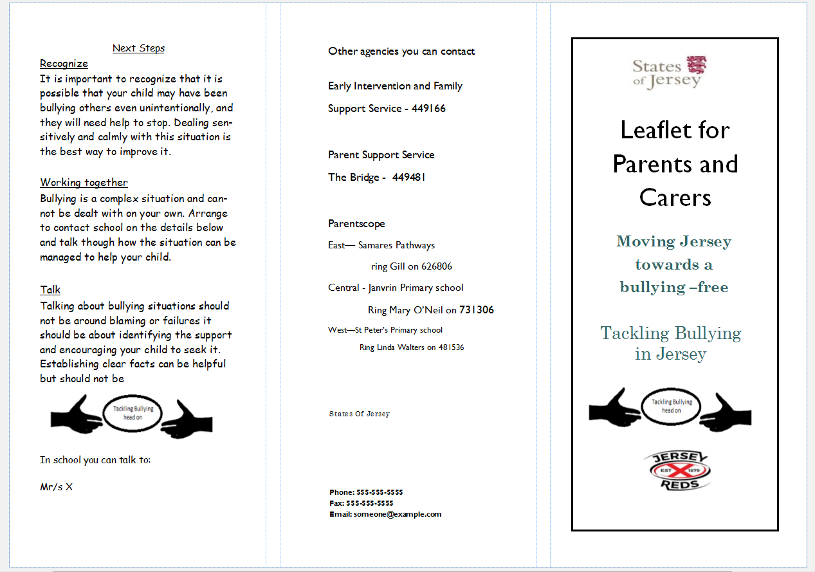
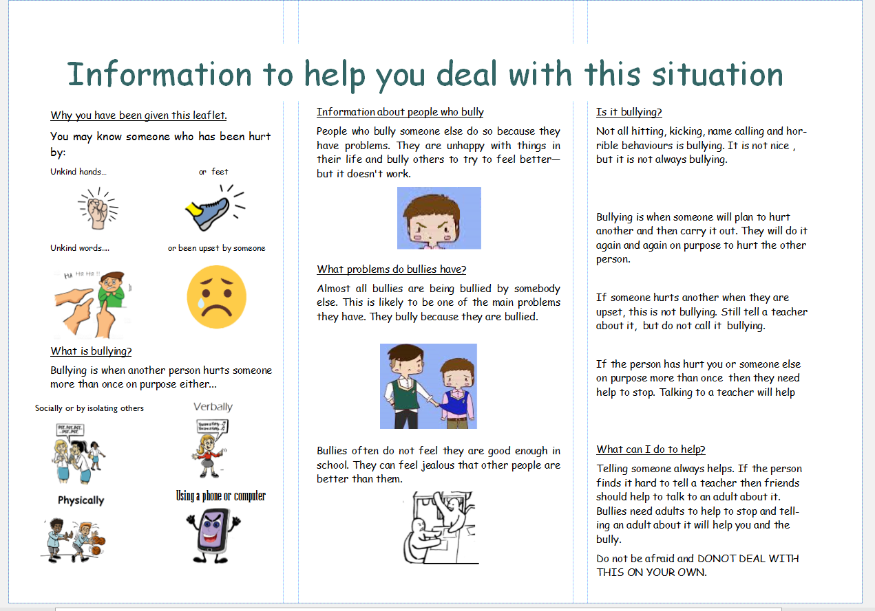
New resources-leaflets

Slide 16
Other resources
Staff training
Evening session for parents– this one! ☺
Assemblies for pupils - introduction
- ongoing EI work
A more direct use of mental health assessments and well-being approaches

Slide 17
Facts driving this project
Children who bully are twice as likely to suffer long-term mental health issues than their victims will.
Bullying is one of many social problem solving tools some children use
The greatest resource in managing bullying is other children (see bully circle)

Slide 18
More facts
About 50% of people say that they were bullied at some point during school in UK and USA.
Year 5 is the most prevalent year for bullying to take place
Secondary school bullying can have longer lasting effects on both the bully and the victim

Slide 19
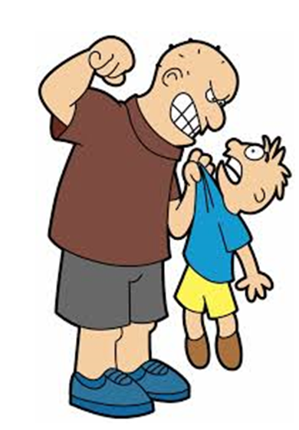
Story of a bully
Low self esteem
Experienced aggression
Experienced rejection
Needs peer approval
Has a need to prove themselves
Have some emotional problems

Slide 20
Why do children bully others?
Children’s responses
because they are sad and they want to make themselves happy
hurt peoples feelings
jealous of the person
because they want friends
they want to be the people everyone is nice to so they make them be nice
might get irritated with other people through arguments

Slide 21
2
some people cannot do the same thing as others
to get attention
because they don't agree to things
others are jealous of what you do
people don't like them
because people are angry at them
they might have been bullied first by someone else

Slide 22
3
so thay can feel powerful and happy
The Bully Is Jelous.
thay are jellis of them because the peson that they are bulling has something they don't
Maybe they have problems going on at home.
they are annoying them
They are jealous

Slide 23
4
because maybe their getting bullyied some where else
they are angry
They have something going wrong in there life and want others to see what it feels like or are just angry.
if they are jellies or angry they could hut you

Slide 24
5
Because something is maybe going on in their home and it makes them feel upset so they want other people to feel their pain
what has happened at school
the bully might have problems at home and their siblings are bullying them
because they want to play with that person
Because they want to show off or to fit in

Slide 25
6
they want something from them
Because they were angry at that person
may be they where bullied
Because they might of been bullied before and now their bulling other people or they are just jellous
They are sad and need to bully to make themselves feel better

Slide 26
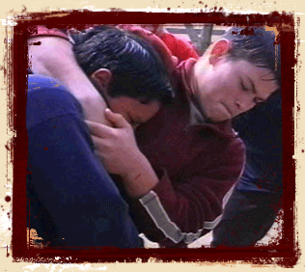
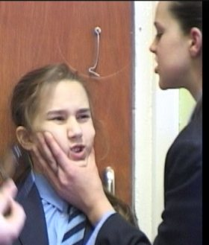
Male vs Female ?
Traditionally…
60% of reported bullying occurs amongst females
The majority of male bullying is either physical and or verbal
The majority of female bullying is psychological and social.
However…

Slide 27
Types of bulling
Verbal – name calling, imitation
Physical - punching, kicking, barging etc
Emotional – taking possessions, hiding objects
Controlling – preventing them doing something, making them do something etc
Cyber – using technology to do the above

Slide 28
Direct and Indirect bullying
Direct bullying is instigating and engaging in the actual act of bullying someone.
Indirect bullying is facilitating, supporting or perpetuating bullying by encouragement and/or non-action

Slide 29
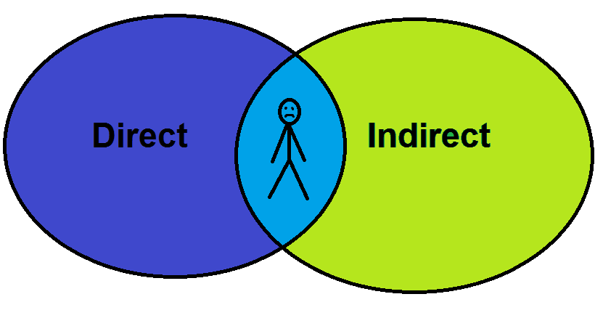
Two ways to be bullied
thumping
stealing
watching
encouraging
excluding
teasing
isolating the victim
cyber
ignoring
mocking
spreading rumours

Slide 30
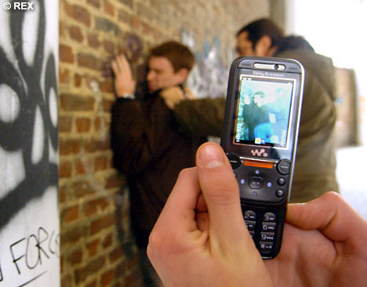
Cyber bullying
Cyber bullying now takes many forms from:
Happy Slapping
Internet – hate email
Photographs
Bashing website – to vote for the five ugliest kids in school ‘click here’
Death threats

Slide 31
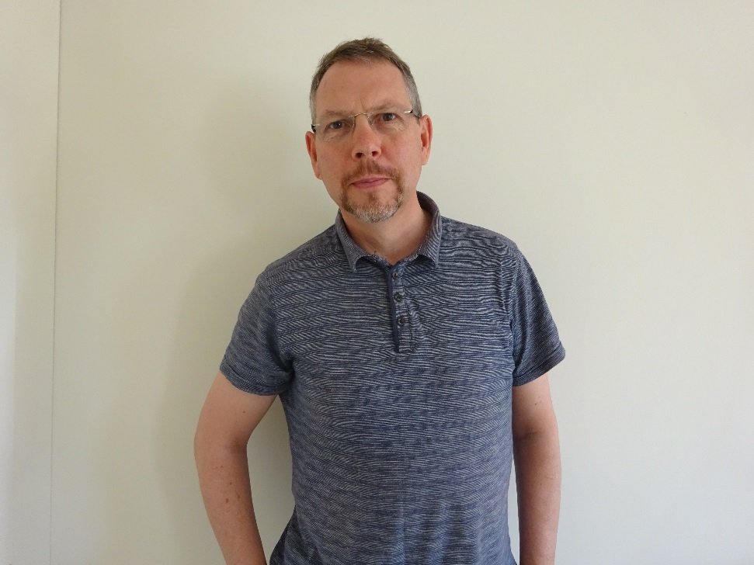
FACEBOOK
Graham RAMSDEN is the ugliest psychologist on the island
VOTE HERE!!
YES 89%
N0 11%

Slide 32
Self-concept
Activity – write down 5 words to describe yourself
An umbrella term that incorporates:
  Self-image – how we come across to others
  Appearance – looks and style
  Ideal-self – the picture we build up of how we
  think or feel we ought to be
Notes:
Facilitator Notes for Slide 5
The purpose of this slide is to explain the difference between the terms self-concept and self-esteem.
Self-concept is an umbrella term that incorporates self-image, ideal-self and self-esteem.
Self-image
The earliest impressions of self-image are mainly those of body-image.
These are supplemented by the sense of being loved or not loved, being clever or stupid (conveyed by verbal and non-verbal messages from others).
These ideas are acquired and influenced by how we perceive ourselves to be valued by those around us, then later by our own evaluations of our competence.
Ideal-self
This develops from the comments and value-judgements of the most significant people in our lives. It is the picture we build up of the ideal attributes and characteristics we should strive to possess – in other words, the standards we set for our lives.
Self-esteem
This is a value judgement about the self. It depends upon the discrepancy between our own self-image and our ideal-self.
If our self-image is poor, then there is little hope of ever attaining our ideal-self and our self-esteem is low.
But if our self-image incorporates acceptable physical appearance, competence in many areas and attributes we feel are valued, then our self-esteem will be high.

Slide 33
Poor self esteem?
Person A
Person B
Thick
Ugly
Stupid
Clumsy
Lazy
Argumentative
Boring
Weak
Gorgeous
Talented
Sporty
Strong
Artistic
Clever
Muscular
Sociable

Slide 34
Self-esteem
Self-esteem is a combination of:
  a general sense of liking ourselves
  being happy with the way we are and the way we live our lives
  judgements about our competence in areas of importance to us.
Notes:
Facilitator Notes for Slide 6
Self-esteem, then, is about our opinion of ourselves.
The importance we attach to different areas of competence is likely to vary through our lives.
Children with high self-esteem have been found to discount the importance of areas where they are less competent, for example, a child with high self-esteem who is good at sport may not be so concerned at poorer academic performance.
Children with low self-esteem are unable to do this. They are dismayed by any difficulties they experience and so maintain a large discrepancy between their self-image and their ideal-self.
We all seek confirmation of who we are (our self-concept) to sustain stability.
Children with low self-esteem note negative comments that confirm their own view of themselves but fail to ‘hear’ positive comments because they do not believe such comments relate to them.

Slide 35
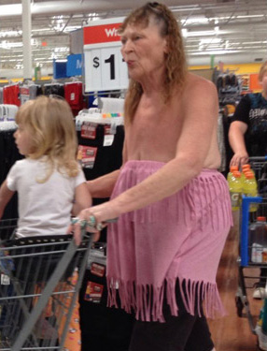
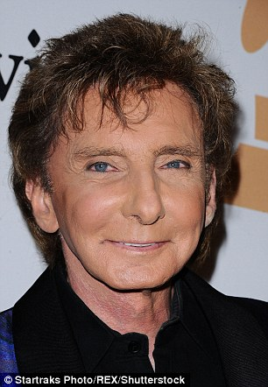
Low self esteem?
Person A
Thick
Ugly
Stupid
Clumsy
Lazy
Argumentative
Boring
Weak
Person B
Gorgeous
Talented
Sporty
Strong
Artistic
Clever
Muscular
Sociable

Slide 36
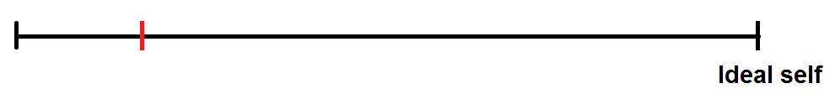
Your ideal self?
Self esteem is how close your perception of current self is to your ideal self

Slide 37
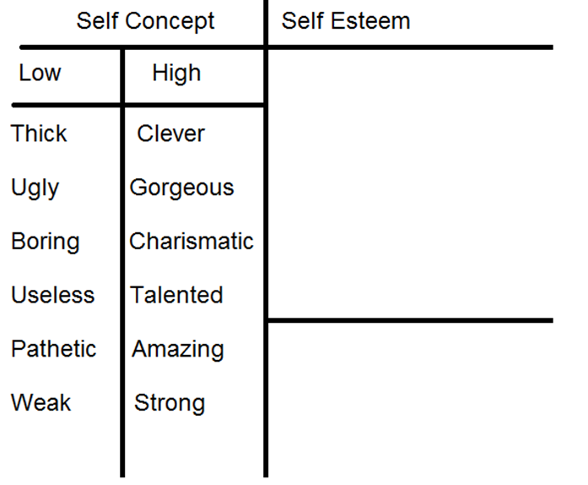
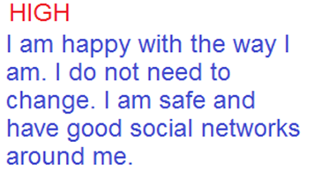
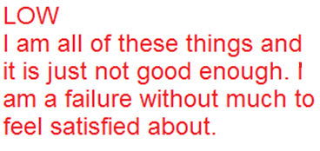

Slide 38
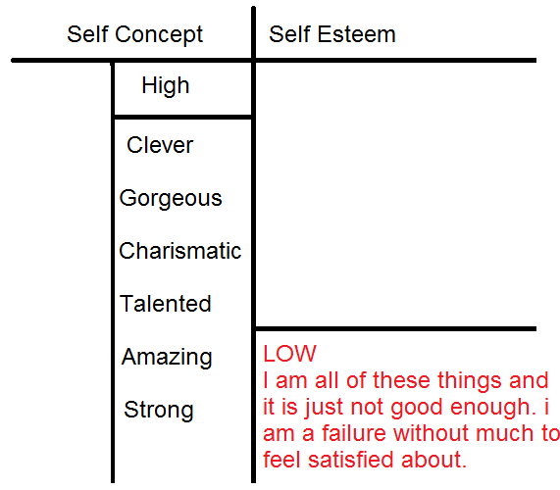
Self esteem in bullying

Slide 39
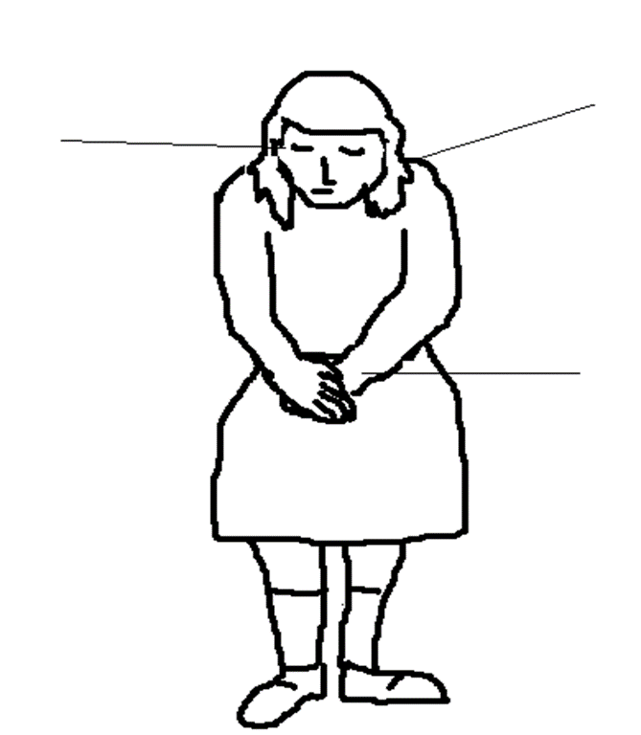
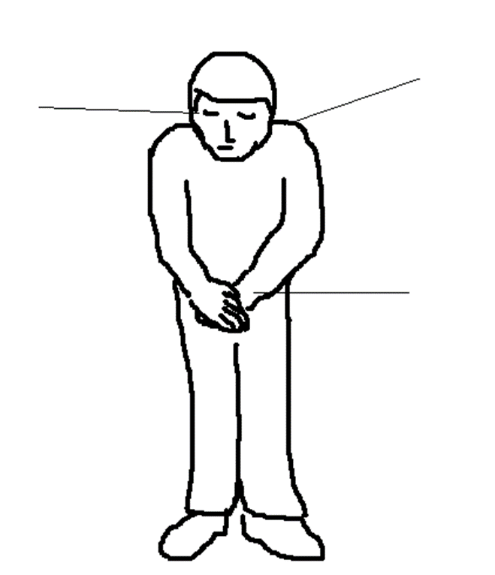
Supporting the victim
Are there any common factors that determines who will be a victim?

Slide 40
Statistics
Looks 52%
Hobbies/interests 43%
Attitudes – higher grades 21%
Household income 19%
Family/friends already being bullied 19%
Attitudes Lower grades – 17%
Sexuality/femininity – 17%

Slide 41
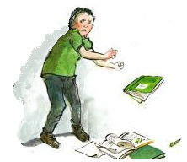
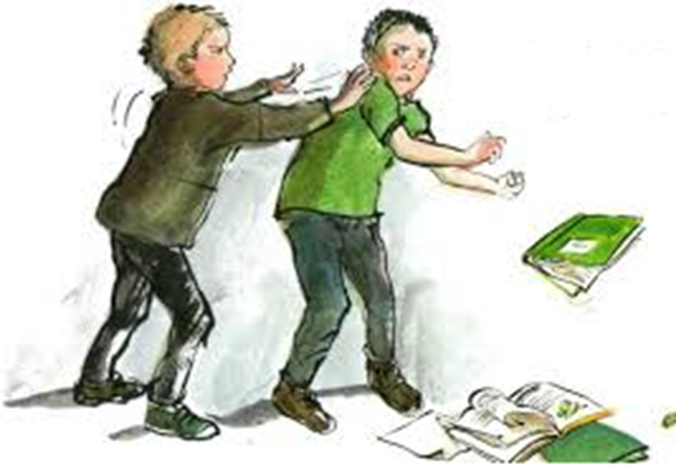
Common factor?
How you respond not what you are like

Slide 42
Profile of a victim - Children’s responses
“It’s usually someone who’s an isolate. Always one individual. One person that doesn’t speak back, doesn’t stand their ground, isn’t the ‘norm’” - Observer
“They target kids who are overweight, awkward and unco-ordinated (for verbal bullying) - Observer
“Honestly, there’s that feeling that I was just the one! I was bullied because I spoke funny, was a bit ‘girly’, and was overweight.” - Victim
“I don’t have much in common with them. They play netball, I ride a horse. They have lots of power tools, I garden!” - Victim

Slide 43
Profile of a victim
Some are passive and loners.
They cry easily.
They lack self-defence skills.
They aren't able to dodge a conflict with humour and don't think very quickly on their feet.
About ten to fifteen percent of victims can be described as, "provocative victims."
These children are restless and easily aroused emotionally. They are teasers. They fight back against bullies and come back for more. Less skilled in fighting than bullies, they mostly lose those fights.

Slide 44
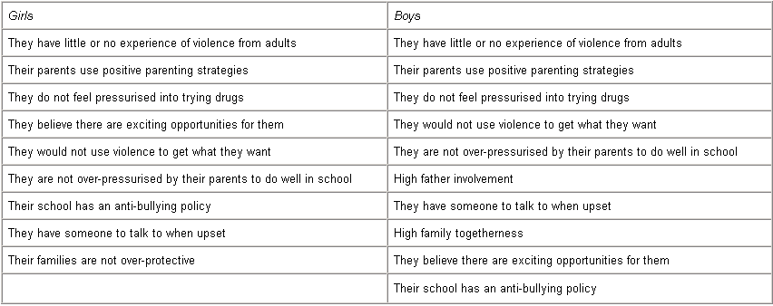
Key characteristics that protect children from being bullied (Katz et al., 2001)

Slide 45
Role of parents in bullying
Being aware of the new leaflets being used
Working in partnership with school to reduce bullying
Accept that children who bully need as much help as the victims do (if not more) .
Attend school requests to talk about the incident (as a parents of a bully as well as those of a victim)
If your child uses bullying methods to cope, teach them better ways to manage their feelings condemning or ‘over-punishing’ them makes the situation worse. If you feel the need to punish – use ‘appropriate consequences’.

Slide 46
If your child has been bullying others
Don’t panic – help is at hand
Reassure your child that you will be helping them change their behaviours
Understand that school will profile them to see where they may need to be helped (ABQ-C)

Slide 47
If your child has been a victim of bullying
Don’t panic – help is at hand
Reassure your child that you will be there to support and help them and the child who has been bullying others
Understand that school has a range of support mechanisms in place (ELSA, Well-being) to support your child
Work at a class /school level will continue

Slide 48
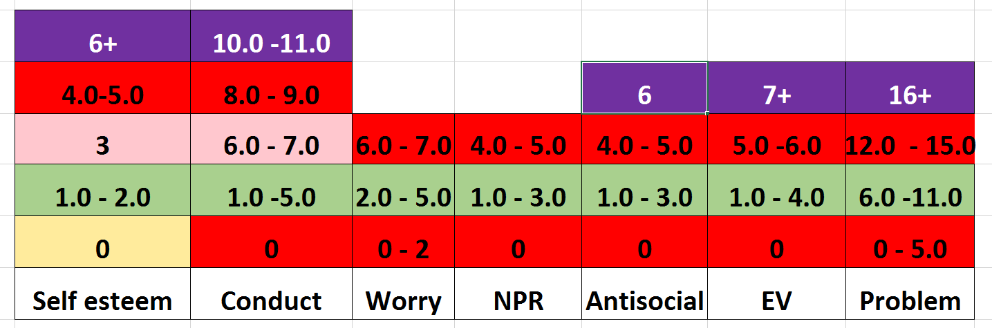
Anti-bullying Questionnaire

Slide 49
Sources of help for parents in Jersey
Parentscope
The Bridge
Family Support Workers
Triple P Training

Slide 50
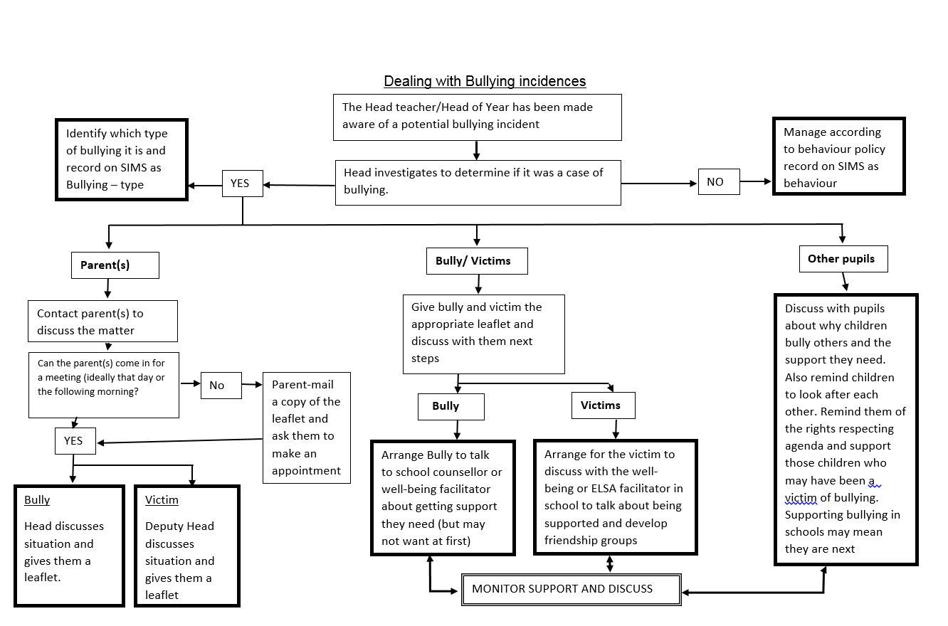

Slide 51
The importance of social groupings

Slide 52

Social dilemma
How would you feel witnessing someone being bullied?
But what would you do about it?

Slide 53
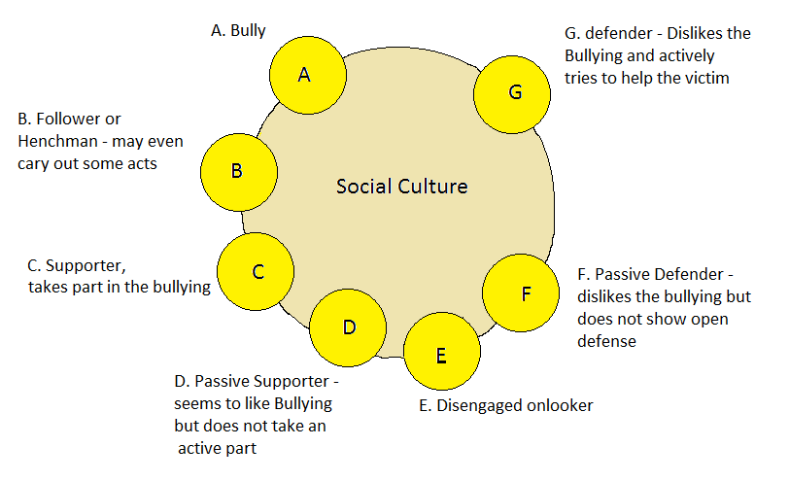
The Cycle of Bullying

Slide 54
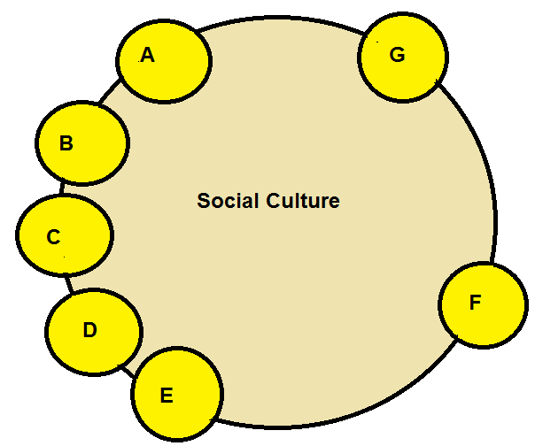
Higher bullying cultures

Slide 55
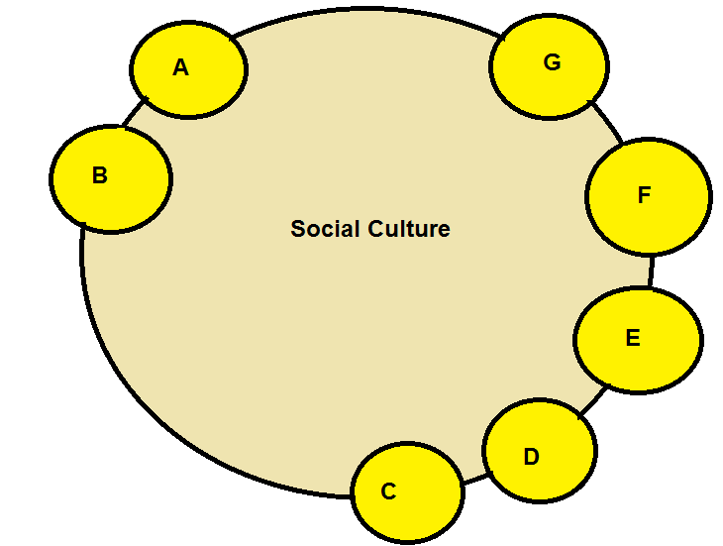
Lower bullying cultures

Slide 56
How do we move children from A – G ?
Change is needed to facilitate movement in:
attitudes towards bullying
perceptions
practices in school
family support strands
Benefits of change needs to be delivered

Slide 57
Helping your child
Child
Bully Location

Slide 58
Helping your child
Child
Bully Location

Slide 59
Helping your child
Child
Bully Location

Slide 60
Helping your child
Child
Bully Location

Slide 61
Helping your child
Child
Bully Location

Slide 62
The project
What next?

Slide 63
Staff have been trained…
Parents are now aware…
Pupils need to engaged in the project

Slide 64
What can your child expect?
An assembly exploring bullying
Some class work around bullying
Guidelines on how to manage a bullying situation
Complete a baseline questionnaire (Y3-6) at school

Slide 65
If they are being bullied
Encouraged to tell someone
Given a leaflet to bring home
Supported through friendship groups
Given opportunities to talk when needed

Slide 66
If they have bullied someone
Dealt with in a supportive manner
Given a leaflet to bring home
Asked to complete a EI questionnaire to help identify what help they will most benefit from
Placed on an emotional support plan
Encouraged to talk about their progress

Slide 67
Conclusion
Education Department
To tackle bullying we need to take a whole school approach
Everyone in school contributes to the culture of endorsing a more bully-free environment
Both the child who bullies and the child being bullied will get support

Slide 68

Time check…

Slide 69
Changing perceptions
The Perceptions of those who bully others

Slide 70
Gathering perceptions
Thematic Apperception Tests (TAT) are projective tests used in psychoanalysis.
This study used elements of TEMAS technique to help build scenarios that were seen to provide varied responses by children in a pilot study.
The TAT tests were administered by class teachers as part of a normal literacy lesson.
The questionnaire was administered by myself.

Slide 71
Have a go
For each picture say what you think is going on. It is important to not think too much about it but put down your first thoughts.
No conferring

Slide 72
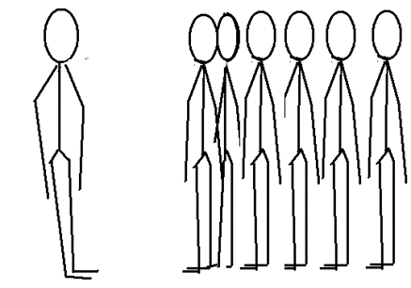
Gender responses
Females responded a lot more to picture 4 with almost 70% of females using a PACE element to it.
Suggests that females more than males see a greater threat from groups.

Slide 73
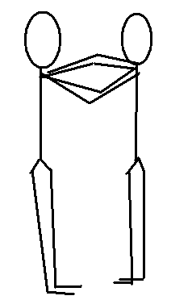
Males saw physical contact (Picture 2) as the most threatening.
This ties in with males using physical aggression as a social problem solving tool

Slide 74
Statistical relevance
0.01% that this is by chance.
Therefore this study shows that Children who bully have greater tendency to overlay aggressive elements onto ‘neutral’ social situations more than children who have not experienced bullying.
Victims also attribute a higher % of PACE than NBE’s

Slide 75
Listening to bullies recall their experiences
Out of the 29 who said they had bullied others, 4 children had said they had never been bullied themselves.
Interviewed four bully/victims and 1 bully only.

Slide 76
Themes bullies raised in their discussions
Clarity was needed in understanding about the different types of bullying
Bullying is a survival technique
Social hierarchies are important (Social Dominance Theory – Sidannius and Pratto (2001)
The quality and role of friendships is vital

Slide 77
Wider implications of school bullying

Slide 78
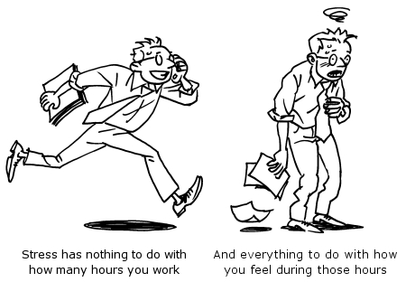
Models of Stress
Stress is the feelings we have when the demands of a situation exceed our ability to cope with it.

Slide 79
Perception is key
How an individual perceives their environment will determine how a person feels they can cope with it. There are two key factors in this
How much stress they have been under
recently – emotional resilience
2. What happened last time the stressful
situation occurred.

Slide 80
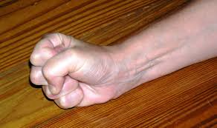
Most children who were interviewed who had bullied others said they did it to feel safer in school! It was as a result of feeling stressed and not having any other options.

Slide 81
Limiting the bullying -advice to parents
Parents work in partnership with the school - bullying will need to supported there as well
Aim to skill your child with some self assertiveness skills.
Talk to your child’s peer group as a group (through the teacher)
Familiarise yourself with the school’s anti-bullying policies

Slide 82
Actions for supporting pupils
Need to change the way that children who bully perceive their social environment
Need to address the situation as a whole school policy and not just dealing with bullies
Need to look at the bully as a victim also
Need to explore alternative choices for those who choose to bully to manage situations
Need to look at using defintions from childrens’ perspectives and not adult imposed ones.

Slide 83
Systemic and Cultural Change
Education Department
Long term change needs a change in:
- our perceptions of children who need to bully
Support systems for victims of bullying
Support for those who bully.
Cultural modelling and respect
Values that are seen not just heard

Slide 84
People who bully
Are (and feel) vulnerable
Have LSE (otherwise why would they need to hurt others to feel better about themselves?)
Are often victims themselves
Caught in a circle of violence
Should be pitied?
Suffer longer term mental health issues

Slide 85
Conclusion
Education Department
Bullying is an emotional subject for all concerned.
It is easy to nurture the victim and condemn the child who bullies – wrong approach.
Punishing bullies without supporting them makes things worse for everyone
We need to find the correct balance between the two.
Working together we can make a difference

Slide 86
Education Department
Thank you for listening
Any questions?

